Slide 1
Class Diagram Analysis Discussion
Step 1: We scoured over all our interview notes for key words and concepts relating to the core programmatic structure.

Slide 2
Class Diagram Analysis Discussion
Step 2: With our list of key words from the interviews we proceeded with noun-verb analysis.

Slide 3
Class Diagram Analysis Discussion
Step 3: With our list of noun and verbs we proceeded with selecting the names of the data structures and methods that we wanted.
The names that we felt like were missing were added.

Slide 4
Class Diagram Analysis Discussion
Step 4: We developed the set of class diagram objects and how that should interact with one another.

Slide 5
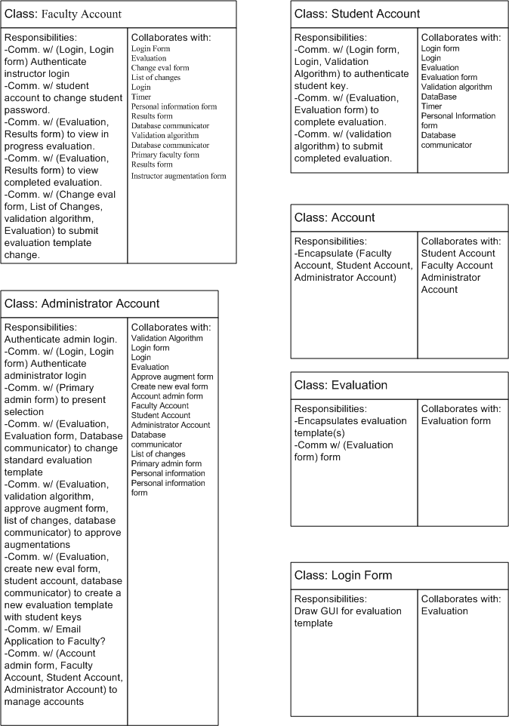

Slide 6
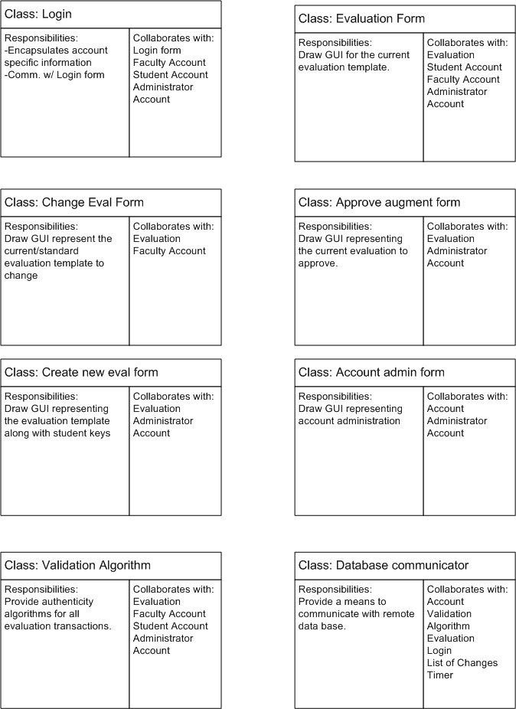

Slide 7
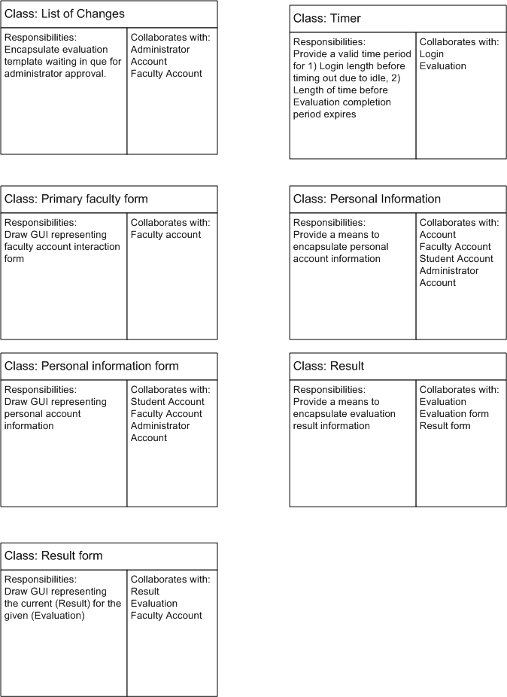

Slide 8
Class Diagram Analysis Discussion
At about week six of our design, we began engaging in a bit more detailed discussion about using a more familiar OO language such as Java with our classes.
We came to the conclusion that we’d have to redo our entire model from a structured webpage layout.

Slide 9
Class Diagram Analysis Discussion
At about week seven, we redesigned our class diagram objects to relational database entity identifier names.
This allowed use to continue with the structured webpage layout model.

